Slide 1
European Touch Referee
Referee, Coaching and Presenting Theory Course –
ReCAPT
Day 2
Notes:
No animations

Slide 2
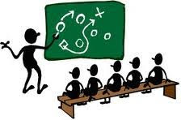
Coaching Module
Notes:
We are starting the coaching module.

Slide 3
Introduction
Aims
We are here today to learn how to help present and coach our up and coming referees in a continually growing and changing sport.
Notes:
Animation for the key aim of the course.
This second viewing of the screen is to link it back to the course beginning. We’ve covered the presenting and now moving onto the coaching phase.

Slide 4
Introduction
How?
By the end of the course you will –
Gain some presenting skills
Understand how to deal with questions and how to question
Have some in class controlled presenting experience
Understand what a coach is, the different types and how they best suit others
Have some in class controlled coaching experience
Have feedback from the above experiences to improve for the real thing
Notes:
Animations half screen from introduction, Understand, experience, feedback.
Expose points as you go have a brief chat on how this happens –
Sometimes people need different things from different coaches.
At the end of the course we will watch videos and coach from these using what we have learned
Received some feedback to help us develop into our new role

Slide 5
Introduction
Why?
Why are you here?
We at EFT ERC have a Vision “To support the development of Touch across Europe by improving referees at all levels of the sport”
What do you get out of it?
Notes:
Three animation points after main screen.
Any new people?
If no-one new has joined us then just re-cap on this.
If new people are here then lets introduce them to others. Start with the group introducing themselves to the new folks. (stand up so they are in the spotlight)
What do you get out of it. Some thoughts on what you can get out of this. –
To grow the referee community in a continually growing sport
To support up and coming referees
Improve referee standards throughout Europe
You are the ‘boots on the ground’ to help shape the future referee
Create a legacy of good referees for the community

Slide 6
Difference between –
Presenter and a Coach?
Presenter - A Person who delivers a message to another.
Coach – Someone who helps identify and rectify problems within a referees performance.
Notes:
Animation for two key points.
Class questions reinforce what you discussed in day one

Slide 7
What is a Coach?
What does a Coach do?
Identify the needs and ambitions of a referee
Guide development of referees
Evaluate and analyse performance to enable improvement
Relay remedial information in the form of constructive feedback
Continually evaluate and improve their own skills and knowledge
Notes:
Animations from what does a coach do. Identify, Guide, Evaluate, Relay and improve
Look back to the flipchart.
Somethings to think about that a coach might do -
Identify needs and ambitions – This is so you can help the referee achieve their goals
Guide the development of referees – Identifies opportunities and help people to exploit and take these chances.
Evaluate analyse performance – you need to be able to see how a referee can improve to get them to improve.
Provide constructive feedback to help referees improve – you’re not going to get anyone to improve if you can’t give them the feedback to do so.
Evaluate and improve yourself to help your referees – keep up to date with the current trends of the sport to adapt and overcome issues.

Slide 8
Key attributes of a good Coach
Communication
Planning and organisation
Analyse
Keeping an open mind
Creating a safe environment
Approachable
Notes:
Animations from main page
Pair up the class and get them to talk through each point..
Communication – Communication skills are paramount for a coach. Communication is mostly thought of as talking or getting your message across. However it is a two way process where listening is sometimes more important. This is particularly true when trying to identify an individuals needs or ambitions.
Planning and organisation – People can soon become bored and lose interest in an activity that isn’t holding their attention, so an ability to plan and organise activities to keep others interested is another key attribute. After using communication skills to identify the needs or ambitions of an individual. Continually adjust plans to keep people interested. Organise a training session to continually challenge referees to keep them interested.
Analyse – We must be able to look at referees to analyse and improve their techniques, physical conditioning, and skills. What are the weather conditions, ground or teams like will have an impact on a referee. It’s important to take these into account to when delivering coaching.
Keeping an open mind – We must be able to listen to others and continually improve our own skills. We must look for new ideas and adapt others ideas to help improve our referees.
Creating a safe environment – You only need to look at the recent cases in football and gymnastics to see how the wrong people can have an adverse effect on the reputation of a sport. You must be aware of your child protection, health and safety and legal responsibilities. You must also be the first point in be a beacon of acceptable behaviour, fair play, anti drugs and confidentiality. The well-being of the referee must be paramount in your mind.
Approachability – self explanatory.

Slide 9
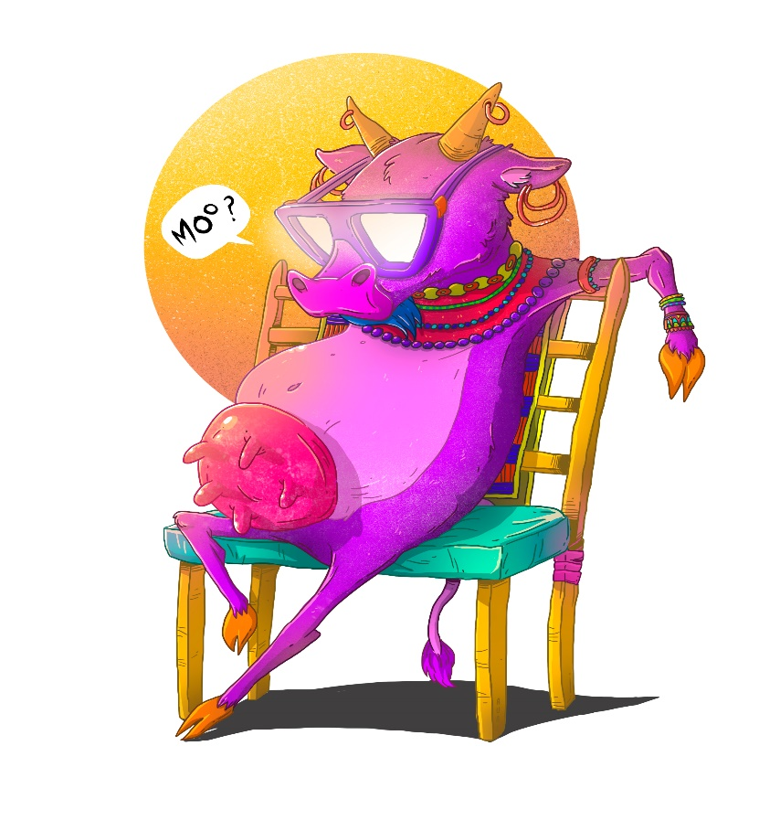


Type of Coach
Three main types of coaching styles –
  Authoritarian, Bossy, Dictator
  Guider, Personable, Democratic
  Minder, Casual, Laissez-Faire

Slide 10
Types of Coaches
Type of Coach | Advantages | Disadvantages | When useful
Authoritarian | To get a better performance from an under preforming referee Quick and to the point | Can cause resentment People will lose interest | When there is a safety issue Good to get newer points across
Guider | A mutual set of goals for both parties | White noise i.e. someone you know well, local refs you see a lot of or friends. You deliver that same message and they never act on it as you’re always saying the same thing. | When guiding mid level referees to develop themselves
Minder | Referees are mostly in control Few decisions to be made | Fewer decisions limits influence or teachings | With Senior referees and only adjusting minor issues
Notes:
Authoritarian – This type has all the information and knowledge. Makes all the decisions on how where why etc. and the referee just does as they are told
Guider – This type involves shared decision. Guides a referee towards selecting and achieving their goals.
Minder – This type involves few decisions and adjust minor issues

Slide 11

Styles of Coaching - On field
Push Coaching –
    Directive/Assertive style
    Sell/promote style
When to use?
Notes:
Animation for the two points after push coaching and when to use
Talk through this
Push Style
Push styles of communication are usually relatively fast in delivery and led by the coach. This is called “push” styles because fundamental aim is to actively coax, cajole or convince the person being coached to accept a message.
We suggest that there are two main push styles that can be adopted:
1. A More Directive/Assertive Style
A Directive/Assertive style of coaching communication typically implies simple statements or repetition of comments, ideas or particular goals accompanied by basically supportive non-verbal expressions.
It also entails some limited acceptance of the other party’s viewpoint in response to what has been stated. In some coaching situations, a Directive/ Assertive style can sometimes create willing compliance rather than independent commitment.
This style tends to work best in coaching when the coach has a lot of knowledge or expertise and the referee needs to learn from this – a tennis coach trying to teach an individual how to play a new shot would be an example in the sporting world for example.
2. A Selling/Promoting Style
A Selling/Promoting style of coaching communication basically means literally selling or promoting a particular goal or outcome by describing it in the most positive terms.
This can be done ethically by describing real benefits and advantages or unethically by distorting the information about the goal to achieve a result on any terms. The selling/promoting style usually needs a strong sense of trust and can consequently sometimes run the risk of the other party feeling manipulated.
This style tends to work best in coaching when the coach is trying to deal with a performance shortfall or lift individual performance to a higher level (where a degree of “selling the benefits or pointing out the shortfalls of not acting or changing need to be promoted strongly).
The above styles are ‘push’ styles because they are typical exerted pro-actively or initiated by the coach in the relationship – that is they are often presented without invitation by the referee (or foisted upon him or her) with the primary aim of seizing the conversation initiative and pushing for an outcome that the coach desires.
When to use ask the class the question, lots of talking and no involvement here –
Best used when needing to get the information across in a limited timescale. Half-time for instance.

Slide 12
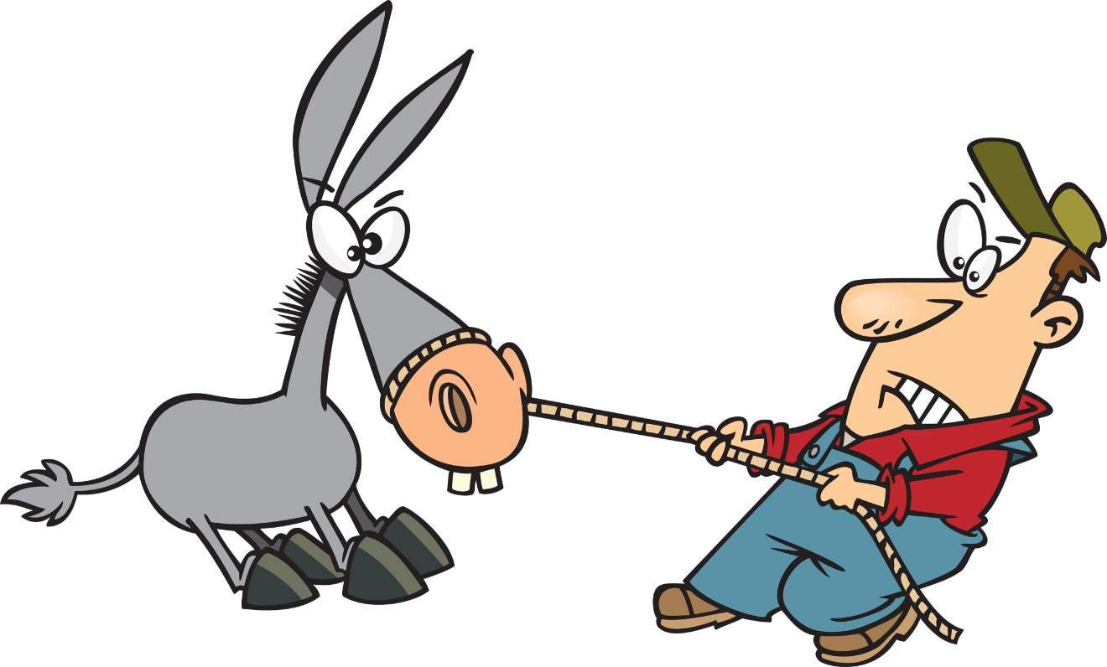
Styles of Coaching – On-field
Pull Coaching –
    Educative/Promoting Style
    Passive Style
When to use?
Notes:
Animations for two key points after pull coaching and when to use
Talk through this
Pull Coaching
Unlike push styles of influence, pull styles seek to draw out the message or issues to be delivered or communicated at a slower, gentler pace. They are called “pull” styles because the fundamental aim is to primarily or mainly listen and respond to the referee (commenting upon their agenda rather than pushing an agenda of the communicator’s own).
We suggest that there are two main pull styles that can be adopted:
1. An Educative/Expert Style
An Educative or Expert style of coaching communication implies the provision of information to help guide the referee, but it is likely to be information on what might be unknown to the other party rather than presented as superior knowledge.
Hence a coach might present “Did you know that….” type of information as part of the discussion.
In using this style, the information needs to be relevant and reliable and typically offered in a quiet non-directive way to a referee.
This style tends to work best in coaching when the coach needs to impart from specialist information to a referee or tactical options perhaps but leaving the referee to decide for him of herself having considered the input.
2. A Passive Involvement Style
A Passive Involvement coaching communication style usually means gently steering the conversation towards a goal or an outcome that has already been identified by the referee.
This style entails considerable listening and paraphrasing and utilizing positive and encouraging language as much as possible (usually with considerably more listening to the referees’ perspective rather than talking).
This style tends to work best in coaching when the referee is already knowledgeable and even knows that the options are but needs some minor levels of reassurance before acting independently.
When to use ask the class the question, lots of talking and no involvement here –
Best used when you have a lot of time. Time to listen and lead a conversation to get its outcome. After the match possibly.

Slide 13
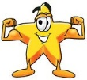
Styles of Coaching – On-field
Strength Based
When to use?
Notes:
One animation for when to use?
Talk through this
Strength Based Coach
This style is widely used and starts with finding the strengths of a referee and building on this to ensure the referee has a clear defined direction. This style is really positive and builds a good relationship between the referee and referee coach.
Building on strengths works best when you are trying to link information.
As an example, you have a very fast referee that can’t seem to get to position from entry and is always chasing the game. The strength here is speed.
Adjust the entry position of the referee so that they enter the field in a smarter position and then point out the flow on benefits.
Best used with referees who like positivity.
When to use ask the class the question, lots of talking and no involvement here –
Best used when you have a lot of time. Time to listen and lead a conversation to get its outcome. After the match possibly.

Slide 14

Style of Coaching – Off-field
Vision Coaching
When to use?
Notes:
Vision Coaching
Vision coaching is a coaching style with an emphasis on future-thinking.
The more we focus our minds on a vision of an outcome we desire, the more likely it is that the outcome will occur.
This approach is ideal when there is a specific goal or outcome to achieve
When to use ask the class the question, lots of talking and no involvement here –
Off-field on a one to one basis when you have lots of time, between games end of tournaments etc..

Slide 15

Style of Coaching – Off-field
Solutions based coaching
When to use?
Notes:
No animations
Talk through this
Solution Focused Coaching (a bit more for you to consider/digest)
Solution-focused coaching is concerned with what a Referee wants to achieve in the end.
A solution focused coach will question a Referee about this goal in order to clarify his or her vision.
What is it they really want?
How are they going to get there?
What happens once they do get there?
Solution-focused coaching encourages:
Introspection (observation or examination of yourself)
self-evaluation (where you are at this stage)
clear goal setting
A richer understanding of one's own unique path in life.
Setting clear goals and focusing on solutions can be very useful in Referee coaching especially for Elite Referees. It can also work well for referees trying to develop themselves personally as it encourages self-evaluation
When to use ask the class the question, lots of talking and no involvement here –
Off-field on a one to one basis when you have lots of time, between games end of tournaments etc..

Slide 16

Style of Coaching – Off-field
Video analysis -
When to use?
Notes:
Animations , when to use and context
Talk through this
Video Analysis
Lots of games now are finding their way onto Facebook, You tube and BBC. This gives us an opportunity but also has its issues. The coach should be aware that this style of coaching needs to be very accurate as the video shows all.
This tends to get quite negative as videos show up everything.
When to use – after you’ve sat down and analysed. Couple of days/weeks. Experienced refs not newer ones. Hardy personalities.
See next slides an email and filled out analysis of a game at the 2018 Euros that was analysed and sent whilst the coach watched the BBC feed. You can see the coach try to inject some positivity into it but it is difficult not to see how negative that may seem to a newer referee.

Slide 17
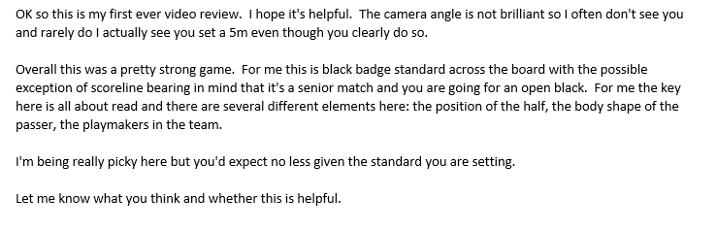
Styles of Coaching – Off-field
Video Analysis – The e-mail
Notes:
Animation for the picture –
Set the context here.
See next slides an email and filled out analysis of a game at the 2018 Euros that was analysed and sent whilst the coach watched the BBC feed. You can see the coach try to inject some positivity into it but it is difficult not to see how negative that may seem to a newer referee.

Slide 18
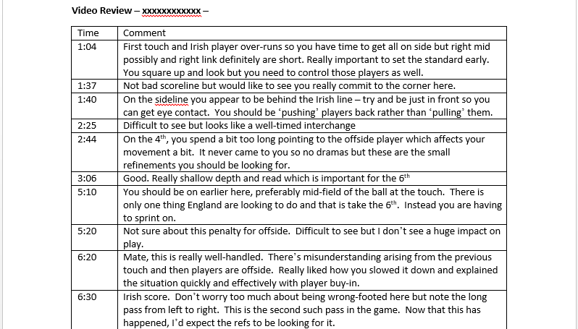
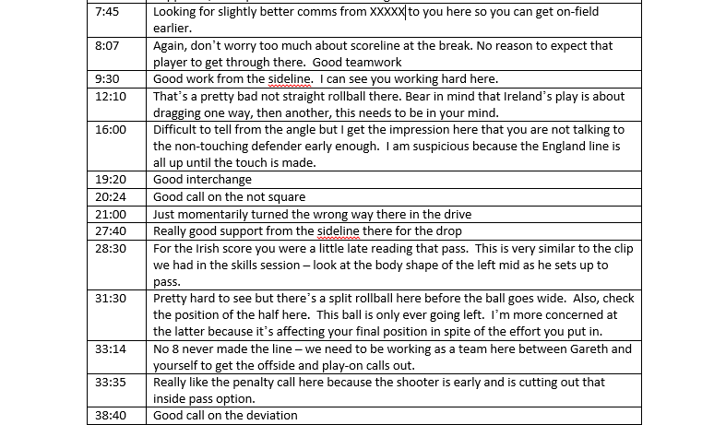
Styles of Coaching – Off-field
Video Analysis – The analysis
Notes:
Animation for the picture –
Set the context here.
See next slides an email and filled out analysis of a game at the 2018 Euros that was analysed and sent whilst the coach watched the BBC feed. You can see the coach try to inject some positivity into it but it is difficult not to see how negative that may seem to a newer referee.

Slide 19

Feedback
SET THE STAGE – make it comfortable
Positivity is important
Two main ways to give
  PRO
  Sandwich or Balloon
Notes:
five animations one per bullet
SET THE STAGE – make people comfortable, turn the away from sun, move them into shade/out rain/in heat, make sure they’re taking on water, relax them.
Talk people through this
Not everyone will get everything right first time. You will have to give feedback, mostly at the side of the pitch. If people have done everything right don’t be afraid to say this to them. DON’T MAKE IT UP!
Two main ways to give it
PRO
Sandwich

Slide 20
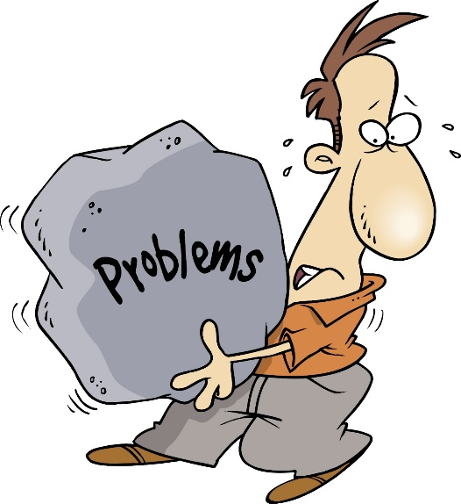


Feedback
Problem
Resolution
Outcome
Notes:
Three animations 1 per point with pic
Explain this to the class
Identify the problem be clear on what it is for example – when you set your five metres you set it well behind the line and allow people to stop somewhere in front of you.
Give them a solution to resolve this – If you move forward into the line this will give players a better and more consistent idea of when they’re onside.
Outcome (what is in it for players but importantly them too) – Players will know exactly where they need to be to prevent penalties, taking out the penalties will make the game flow better and more importantly give you less to run to mark penalties.

Slide 21

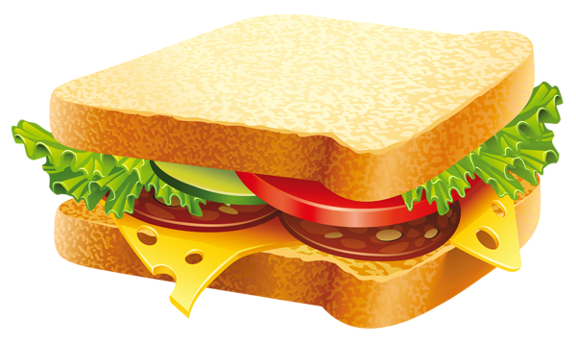
Feedback
Sandwich
Blow, burst, blow
Notes:
No animations
Sandwich ,two pieces of bread surrounding the filling. The two pieces of bread are ‘good’ things surrounding the ‘bad’ thing. Blow up your balloon, ‘make it happy’, Burst it ‘make it sad’ then blow it back up again!
Start with a compliment. Begin the conversation by saying something positive to the other person. You want to start this talk on a positive note. It will help keep the other person from becoming defensive
Be specific. Make sure that your compliment is not vague. That might leave the other person feeling like your feedback isn’t directly applicable to them. Include direct statements about their performance.
Be sincere. Don’t compliment someone just for the sake of it. You risk coming off as phony and damaging your credibility. Find something that you honestly feel the person did well to talk about.
Offer constructive criticism. Do not just tell the person what they are doing wrong. Constructive criticism means that you also need to provide some ideas on how they can improve. Tell them what they are doing wrong, then tell them how to fix it.
Be direct. Do not try to dodge the issue. Get straight to the point. After your positive statement, deliver the feedback in clear, straightforward terms.
Be brief. Don’t ramble on. Your statement should be direct, and it should also be brief. You’ll be able to follow up on the issue later. During the feedback sandwich, keep it short so that your message is easy to understand
Give clear guidelines. The point of giving feedback is to help the other person succeed. Avoid telling them vaguely what you need from them. Instead, give specific goals to meet.
End with an encouraging statement. You will also wrap up your talk by offering some additional positive words. This is the second piece of bread in the feedback sandwich. This helps ensure that the conversation ends on a positive note.
Be objective. Avoid using “I” statements. These are things like “I don’t like how you did this” or “I feel like you are not trying”. Instead, use actual facts to support the points you are making.
Focus on the situation instead of the person. Leave your personal feelings out of it. Sure, you might feel some negativity towards the other person, or maybe you just don’t click. Don’t let that inform the criticism that you are giving.
Give task specific suggestions. Try to avoid giving vague suggestions for improved performance. Something like, “You need to do better” is not really helpful. Instead, talk about the actual thing that needs improvement.
Give timely feedback. Try to give your feedback when it can still be helpful. If you wait until you are completely dissatisfied, there might not be much time left to salvage the situation. If you notice a problem, address it quickly. If given correctly, your feedback could help the other person improve.

Slide 22

Questions
Notes:
Do you have any questions?
Talk me through PRO or Sandwich feedback

Slide 23
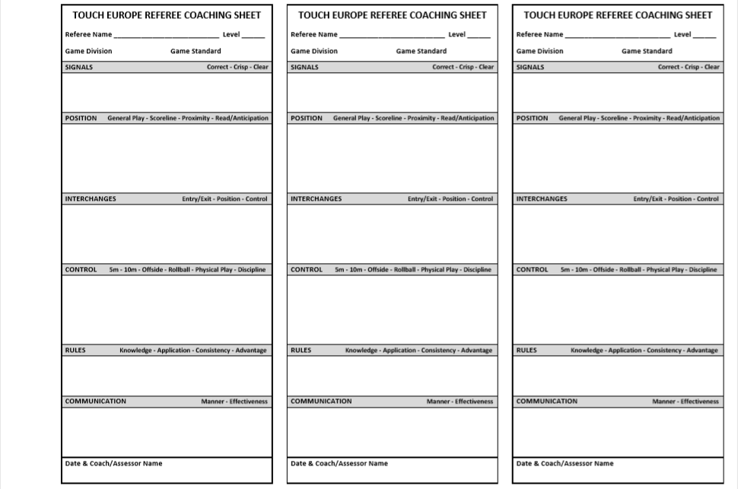
Coaching Paperwork
During game
Notes:
Animation for the picture
Talk people through this paperwork
During the game its important to remember what we need to talk to our referees about. However sometime we can forget.
To help us remember we have some paperwork to do.
Get people to do this as we watch the videos

Slide 24

Video review
Notes:
Set the context of what is happening here. Whoever has video 8 – Two Forward passes.
Get people to watch the next videos and identify the mistake made by the referee and complete the paperwork accordingly.

Slide 25
Coaching Positions
Some questions for you – What are the advantages, disadvantages and what can you see if you;-
  Stand at the top or bottom of the pitch?
  Stay at the side like camera?
  Out the way of the rain or shine?
  Are walking up and down the side-line?
Notes:
BREAK THE GROUP INTO FOUR GROUPS –
Get them to answer the above questions. Write them on a board/flipchart paper.

Slide 26
Coaching positions
Mix it up
  You’ll see/hear more of the game
  Referees won’t have a grudge
  Your credibility is enhanced
  Don’t get comfortable with just one
  Be careful not to overdo it
Notes:
No animations –
Talk people through this its quite self explanatory.

Slide 27
Coaching
Notes:
Ask for any questions
Reinforce knowledge by asking relevant to previous questions.

Slide 28
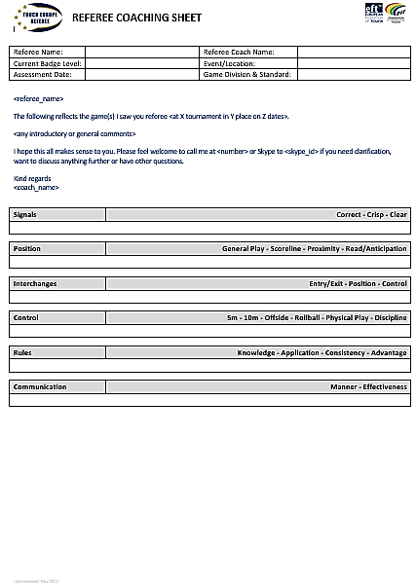
Written Feedback
Notes:
Talk people through this.

Slide 29
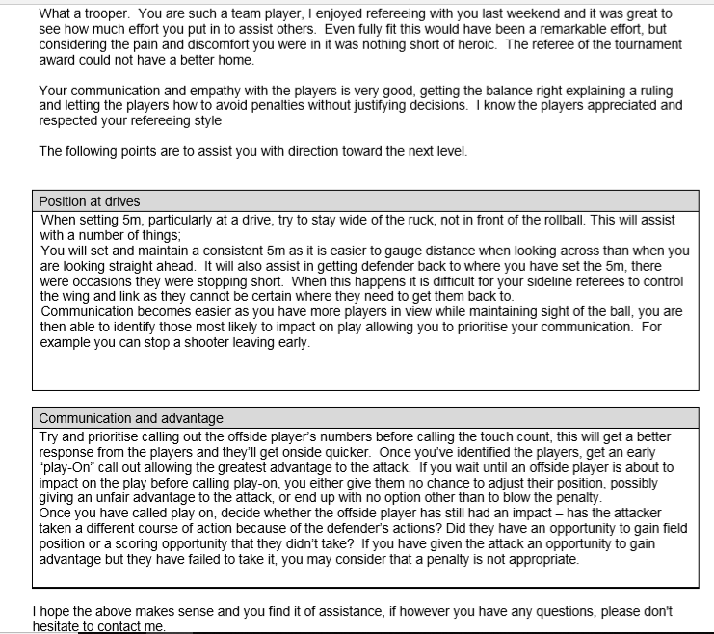
Written feedback completed
Notes:
An example of a completed sheet now get people to fill one out for the videos they’ve just watched

Slide 30
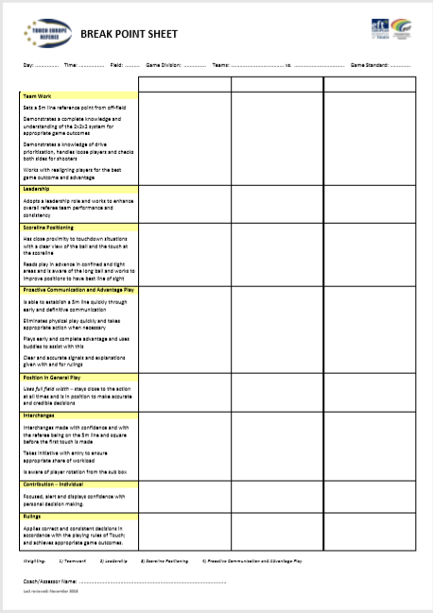
Additional paperwork
Notes:
This is a little more advanced however talk people through a break point sheet.

Slide 31
Coaching
Notes:
Ask for any questions
Reinforce knowledge by asking relevant to previous questions.

Slide 32
Conflict Resolution
Who can create? –
  Players
  Coaches/staff
  Spectators
  Referees
Notes:
Four animations after who can create
Talk through then get class involvement about who they might think can
Conflict resolution will unfortunately be part of coaching. Being the figure seen to be ‘in charge’ you will have people talking to, blaming or trying to influence you.
Players
Coaches/staff
Spectators
Referees

Slide 33
Conflict Resolution
Players
  What can you do?
  What should you do….
Notes:
Animations on –
Players, What can you do – Get the class involved break into groups to get their thoughts.
Now explain what you should do –
Don’t take over the situation see first how things are dealt with by the referee
Don’t undermine the referee
Explain your role is to help the referee

Slide 34



Conflict Resolution
Coaches/staff
  Who are staff?
  What can you do?
  What should you do….
Notes:
Animations from main screen
Get the class involved by asking
Who are staff – Coach, water carriers, medical
What can you do – take each in turn and ask the question
Now you should tell them what they should do –
Don’t take over the situation see first how things are dealt with by the referee
Don’t undermine the referee
Explain your role is to help the referee

Slide 35

Conflict Resolution
Referees with each other
  What can we do?
  What should we do….
Notes:
Animations on –
Players, What can you do – Get the class involved break into groups to get their thoughts.
Now explain what you should do –
Don’t take over the situation see first how things are dealt with by the referee
Don’t undermine the referee
Don’t appear to take sides. Even if one is wrong be tactful.

Slide 36
Conflict Resolution
Referees with you
  How can this happen?
  What can we do?
  What should we do….
Notes:
Animations for three key points
Again class involvement for the first two points
How can this happen – pitched it the wrong way, the wrong style
What can we do
Finally again you explain what you should do -

Slide 37
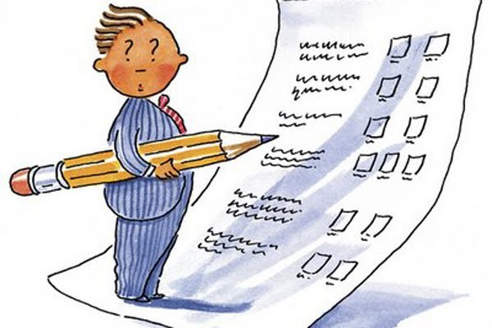
Assessing

Slide 38
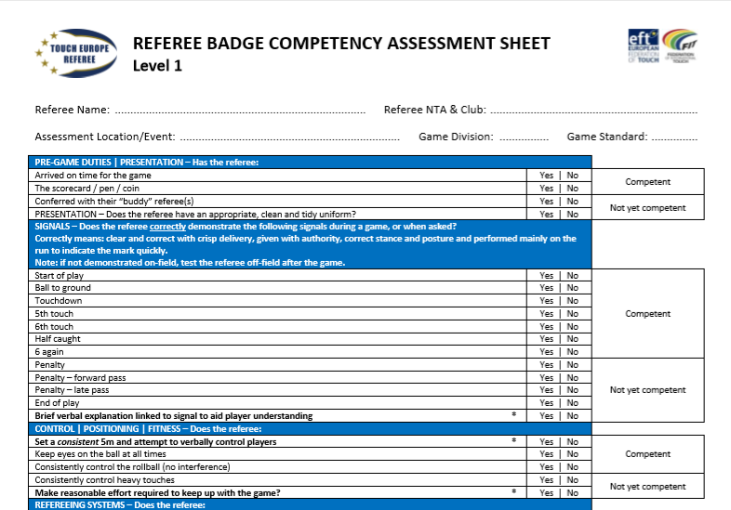
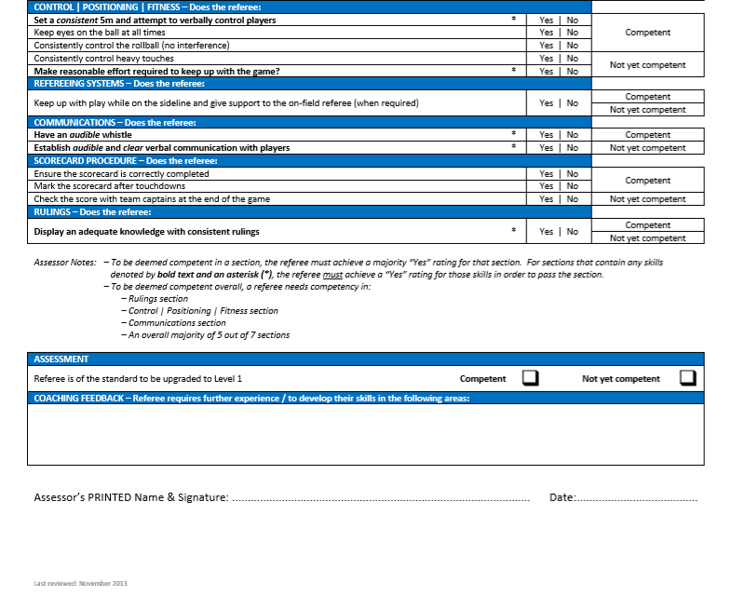
Paperwork
Notes:
Talk people through the sheet drawing particular attention to the how to fill.
Don’t make it up.
Assess on what is there.
Be honest and fair.
Critical when you have to be.
Consistant

Slide 39

Consistency
Ensure the standards and integrity of the Badge system
Reputation of the refereeing community
Being fair to all
Must do
Standard delivery
Its not easy to learn in another language
Notes:
Animations for six key points
We have to be consistent in our delivery and approach to –
Ensure standards – we cannot allow standards to drop between areas. This will allow the courses to be taken in easier areas making it unfair for some.
Reputation – If we make it easy and just give out awards then this will drive down standards. By doing this we leave ourselves justifiably open to criticisms.
Fairness – People should all be treated and expected to pass the same courses to upgrade. Making it easier for a certain person makes it harder for others.
Must do – If there is an exam, course or assessment everyone must do it
Standard delivery – This will allows us to keep it the same for everyone
Language – Its not easy to learn in another language. If we can standardise what and how we say it everyone has the best chance possible.

Slide 40
Summarise
We were here today to learn how to help present and coach our up and coming referees in a continually growing and changing sport.
During this course we’ve -
Identified what a coach is, the different types and how they best suit others
Had some in class controlled coaching experience
Gained some presenting skills
Learned how to deal with questions and how to question
Had some in class controlled presenting experience
Had feedback on your skills to improve for the real thing
Notes:
Use the aims from the

Slide 41

Looking Forward
You’ve got the skills
Experiment learn
Going further?
You’ve qualified to present
Practise
Get help, don’t go it alone
Notes:
Animations for last two points
You have the skills now – don’t go it all alone
You need to do two courses ‘to pass’
One helping out
Second doing it alone with another helping you and ‘signing you off’.
Experiment try out different styles – some will work some wont
Same process for all the levels of presenting and coaching.

Slide 42

Questions

